Slide 1
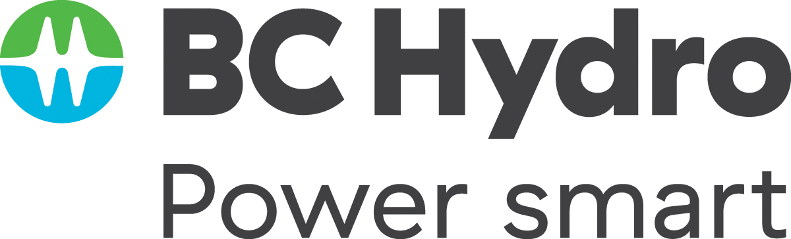



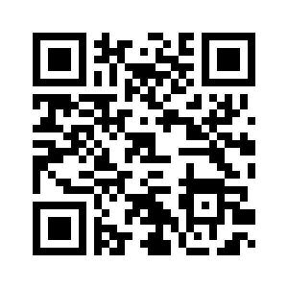
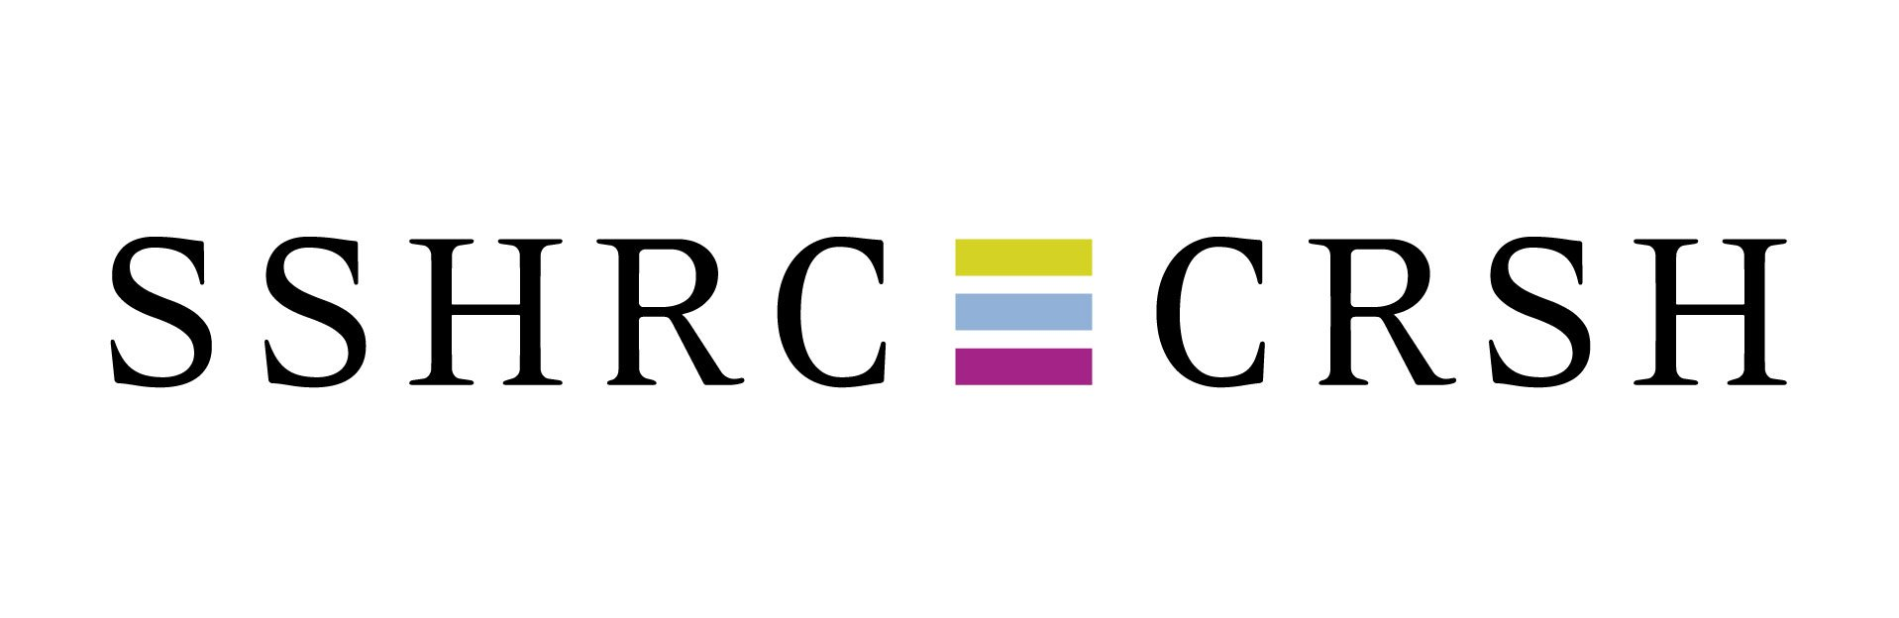
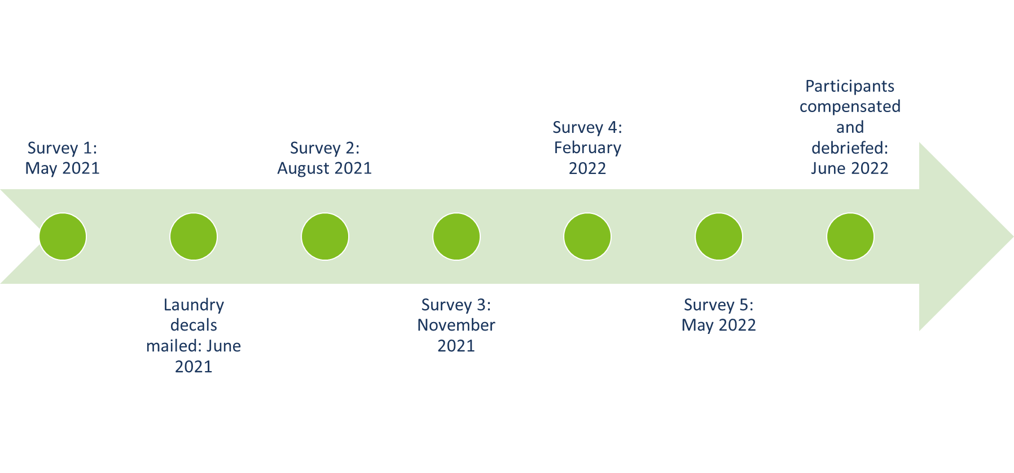
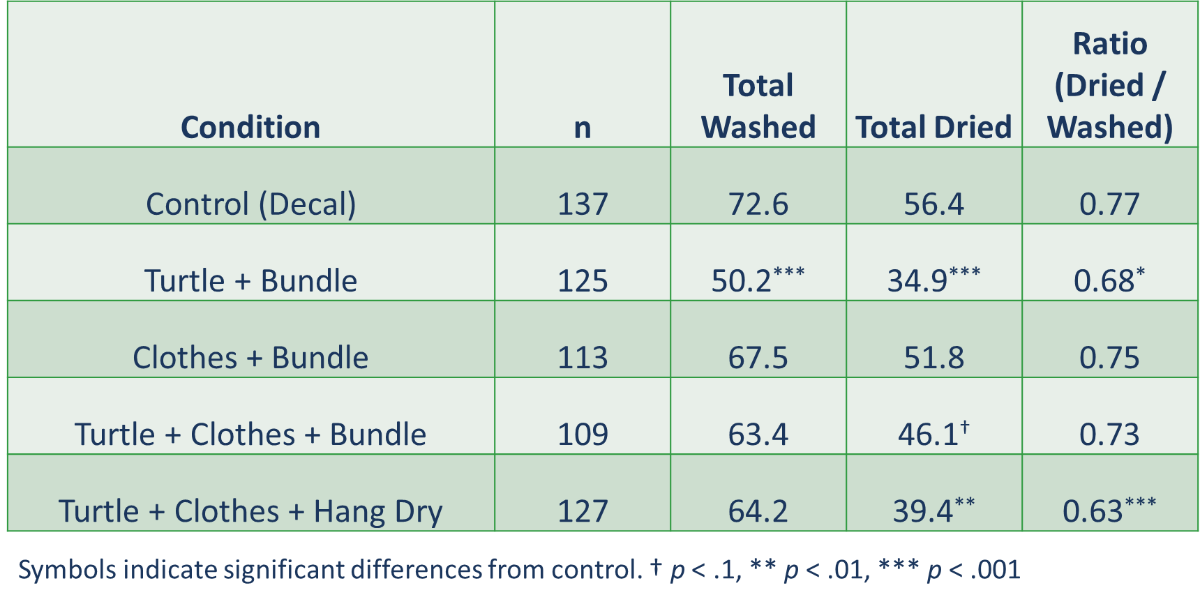
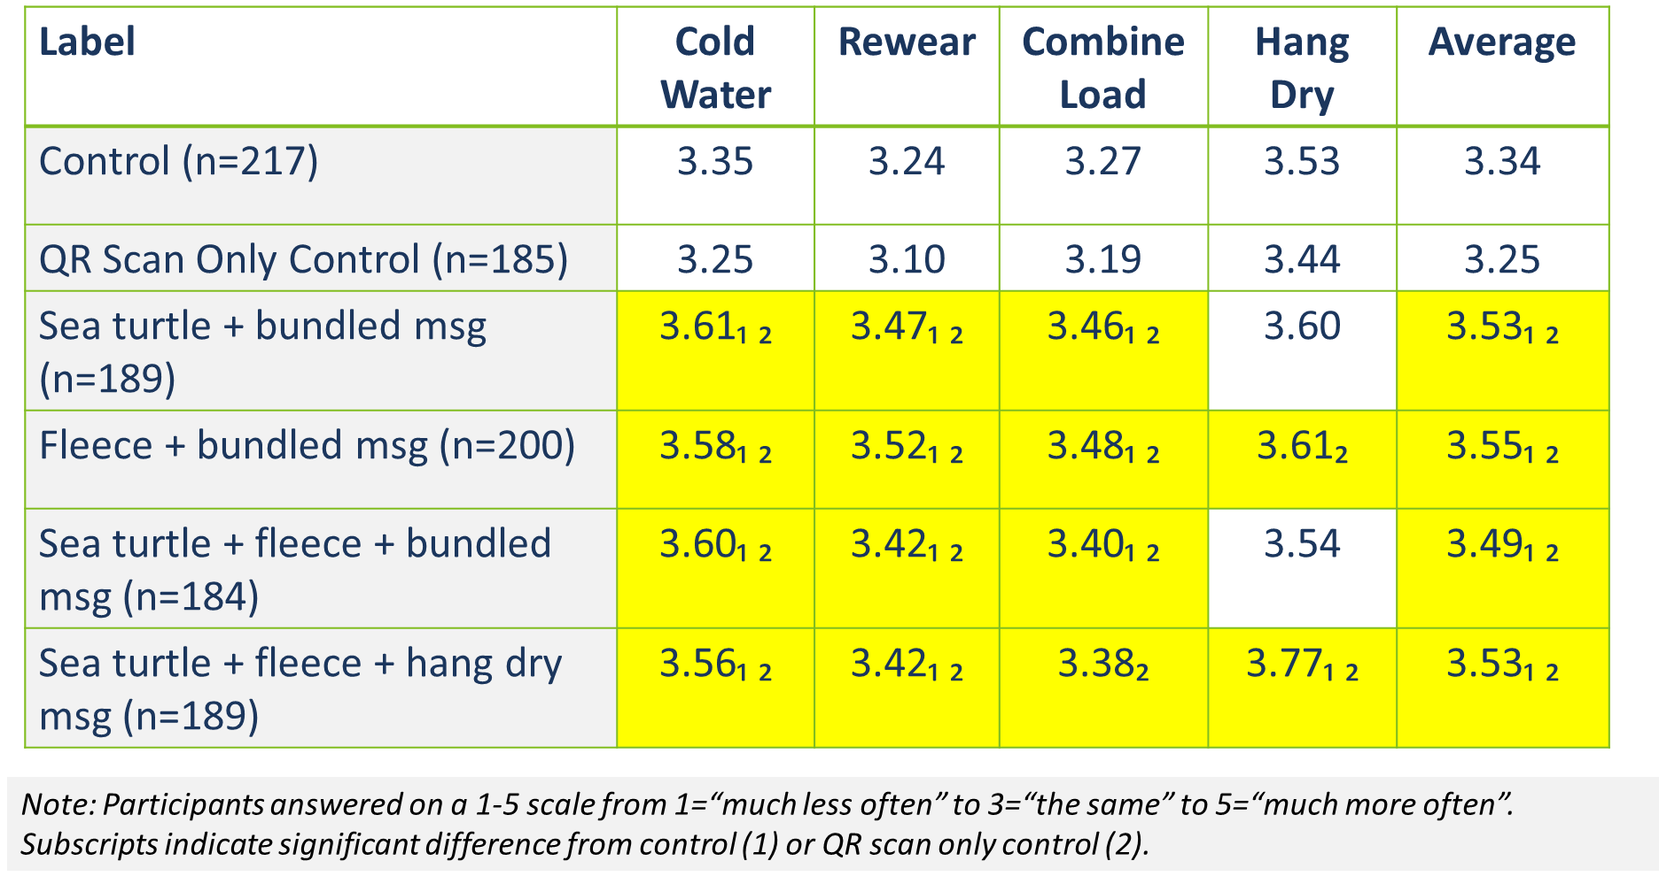
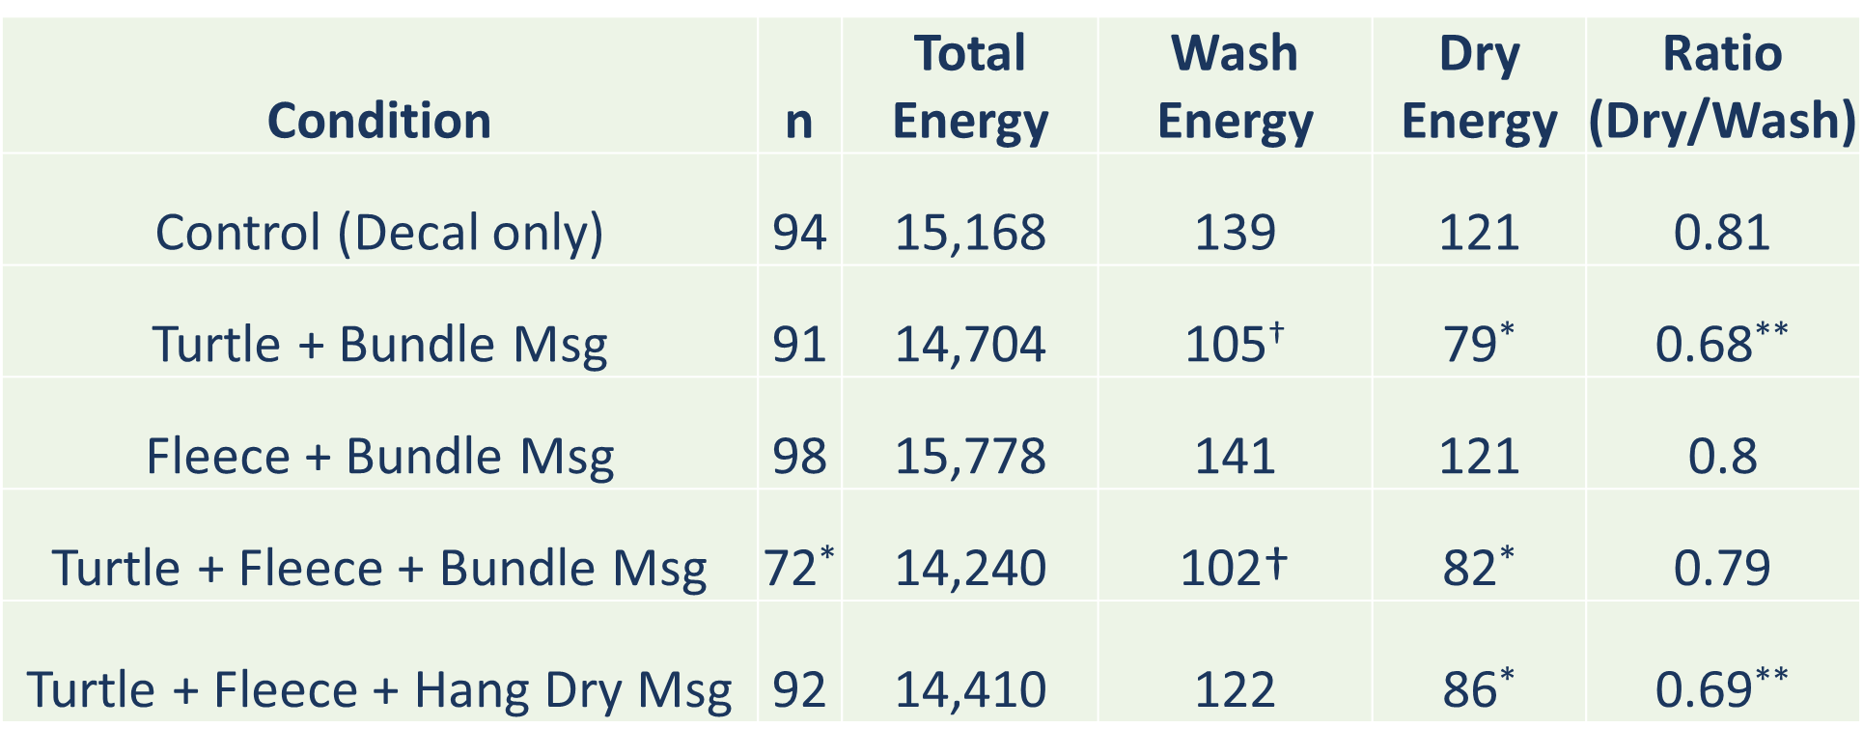
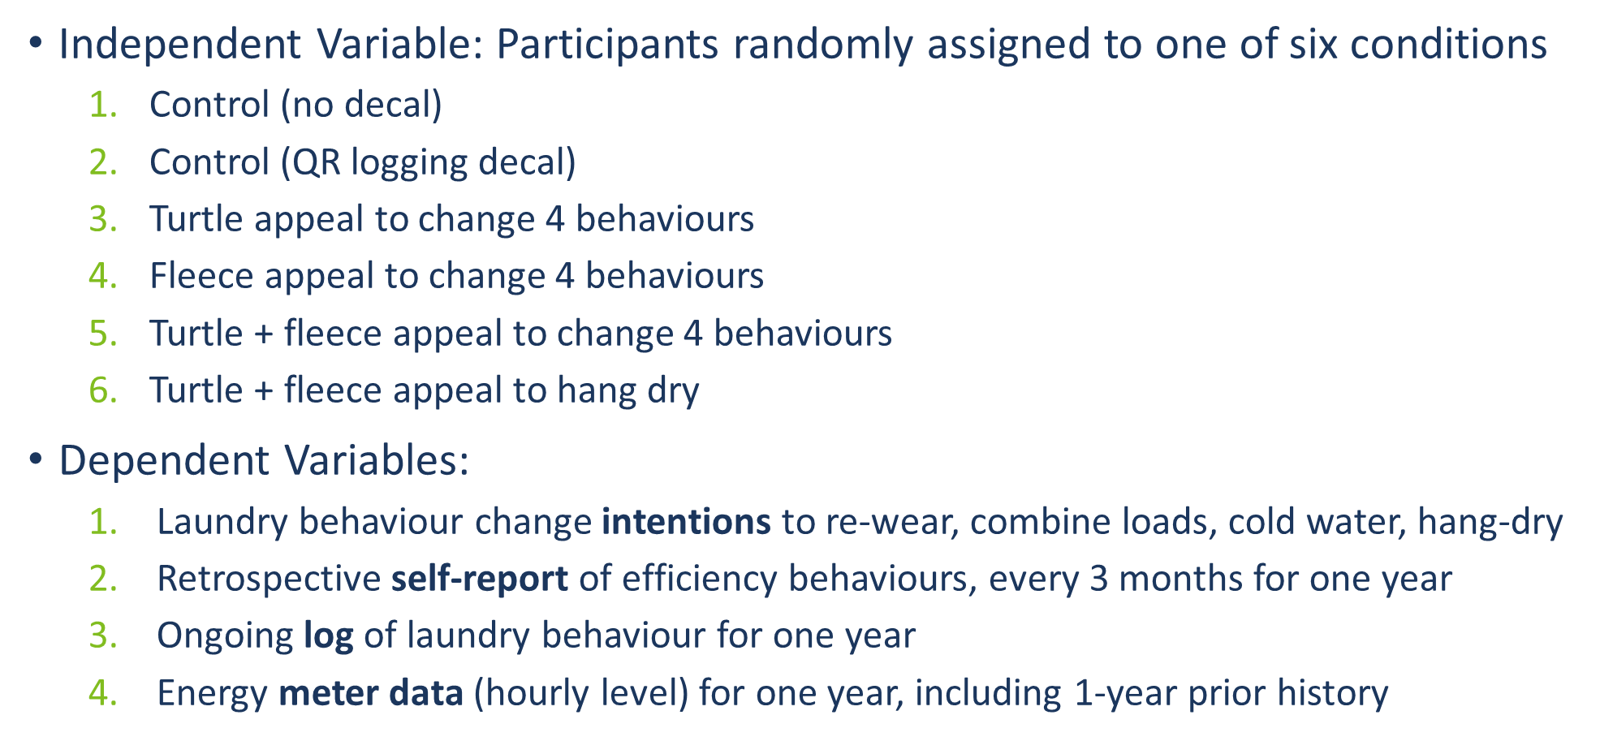
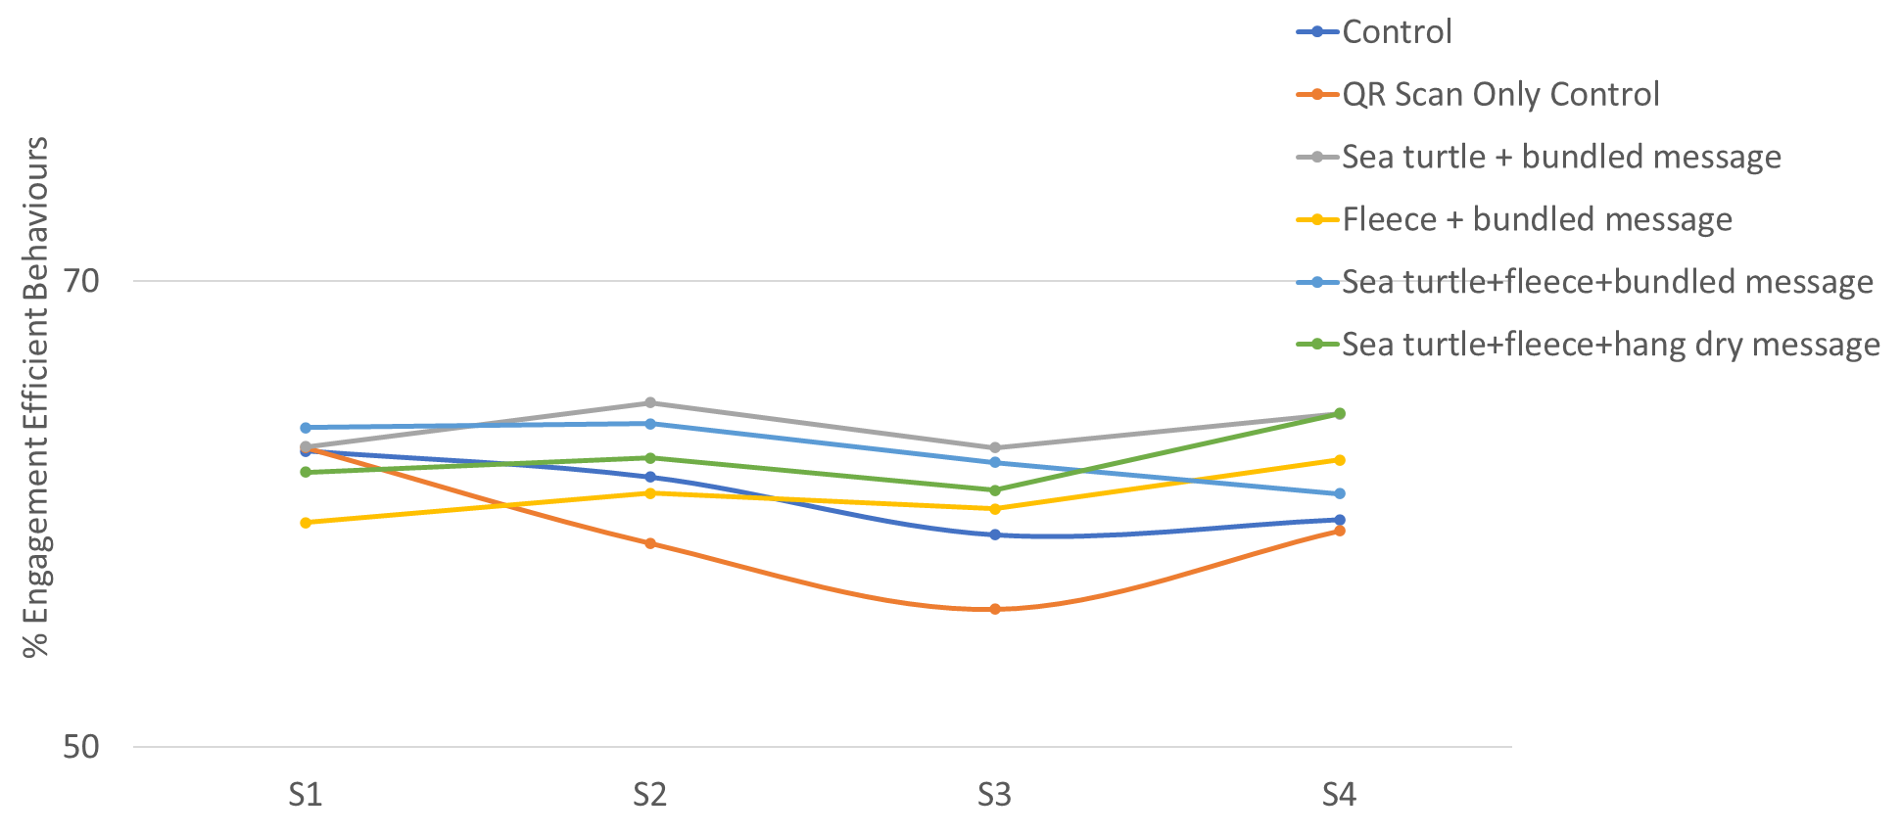
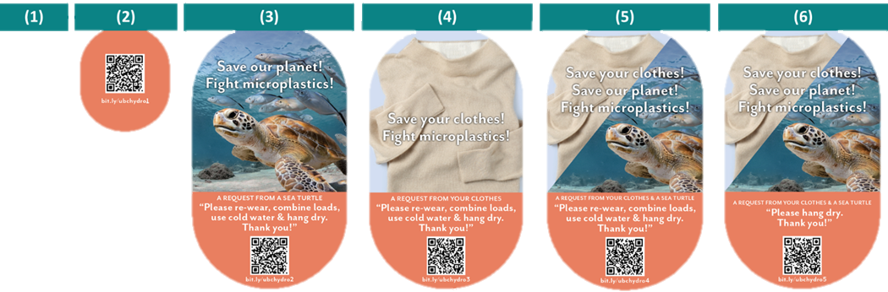
Twice as nice? A longitudinal field study of separate vs. combined nudges for household laundry behaviours
David Hardisty, Kirstin Appelt, Siddhanth Mookerjee, Jiaying Zhao, Yanwen Wang, Arien Korteland
SUMMARY
STUDY TIMELINE
BEHAVIOUR LOGGING RESULTS
Are energy conservation nudges more effective if they focus on benefits for the self, benefits for the planet, or both? And is it better to target one behaviour at a time, or many different behaviours simultaneously?
We ran a longitudinal field study comparing the impact of different laundry machine decals on encouraging consumers to increase four energy-efficient laundry behaviours: re-wearing clothes until dirty, combining many small loads into fewer large loads, washing with cold water, and hang-drying inside or outside.
Residential consumers (N=1,210) were randomly assigned to one of six conditions: (1) control with no decal, (2) control decal with no message, (3) “environmental appeal” decal encouraging multiple energy-efficient laundry behaviours (4) “self appeal” decal encouraging multiple energy-efficient laundry behaviours (5) “environmental + self appeal” decal encouraging multiple energy-efficient laundry behaviours or (6) “environmental + self appeal” decal encouraging only one energy-efficient laundry behaviour.
Over a period of one year, we measured behaviour change intentions, retrospective self-reports of behaviour, logged laundry behaviour, and objective energy meter data. Results show that 1) All four decals with messages increased intentions to engage in energy-efficient laundry behaviour. 2) The “environmental appeal” decals increased objective measures of behaviour change, whereas the “self appeal” decals did not change objective measures. 3) Making multiple complementary behaviour change requests was more effective than making a single behaviour change request. 4) Overall energy consumption did not change across all conditions during the study period.
v
INTENTIONS RESULTS
ENERGY METER RESULTS
STUDY DESIGN
Table above depicts kwH for logging participants. When isolating laundry times,
two conditions were effective: 1) Turtle + bundled msg 2) Turtle + fleece + hang dry.
SELF-REPORT RESULTS
SUMMARY: DECAL EFFECTIVENESS
Condition | Intentions | Self-report | Logged Washing | Logged Drying | Metered Washing | Metered Drying
Turtle + Bundle | ✓ | † | ✓ | ✓ | † | ✓
Fleece + Bundle | ✓
Turtle + Fleece + Bundle | ✓ |  |  |  | †
Turtle + Fleece + Hang Dry | ✓ | † |  | ✓ |  | ✓
Takeaways:
From S1 to S4, participants were less likely to report engaging in laundry efficient behaviours for the control conditions. “Sea turtle+fleece+hang dry” message and “Sea turtle+bundled” message were more effective than control conditions at S4

